Slide 1

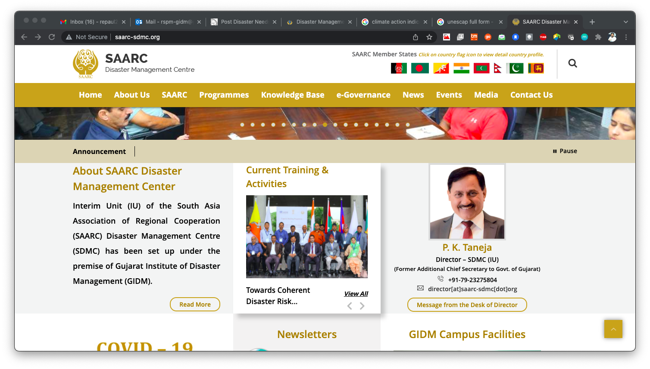
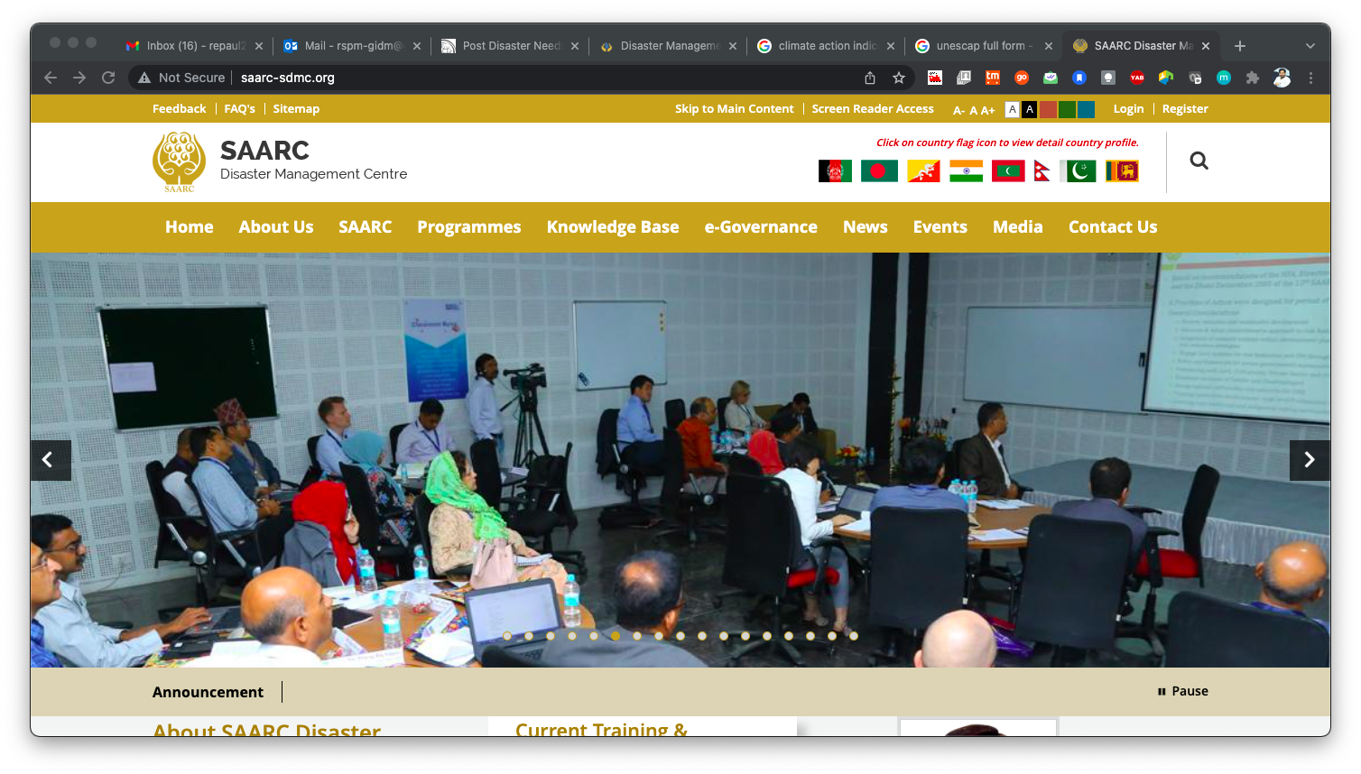
Country Name
Hydro-meteorological Risks in Built Environment

Slide 2
Name of Presenter:
Email:
Phone No.:

Slide 3
Progress made in Nationally Determined Contributions (NDCs)
State of International (Global) Commitments

Slide 4
Progress made in Policy to ensure Climate Resilience
Examples of interventions for Climate Resilient Infrastructure

Slide 5
Progress made in mainstreaming Climate Action in Development
Good practices of climate change adaptation & mitigation

Slide 6
Thank you

